Slide 1
CRAN Data Extraction

Slide 2
Packages Written For The Whole Task
Package Metadata Extractor
Snap Shot
Author Merging
Identity Merging

Slide 3
Database

Slide 4
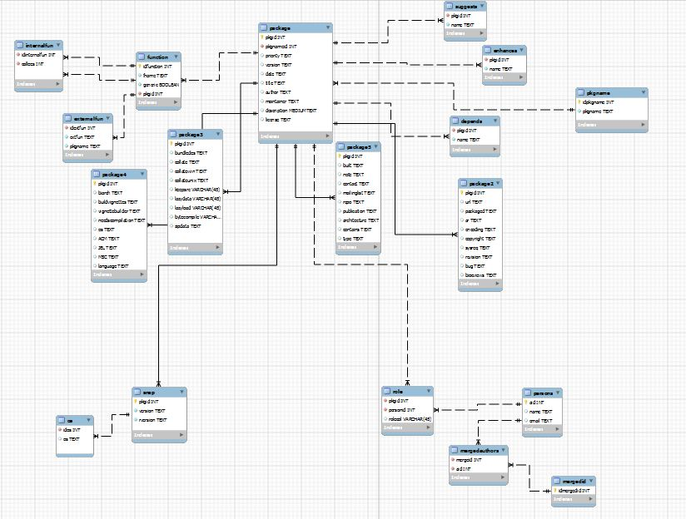
Database Overview

Slide 5
Package Metadata Extractor

Slide 6
Features
Extracts the data from source packages.
Performs the task of description file analysis and functional analysis of the package source files.
Feeds the data collected to the certain tables of the database.

Slide 7
Basic Working
The code first analysis description files of packages and fills the corresponding tables of the database i.e. the tables package, package2, package3, package4, package5, pkgname, depends, enhances, and suggests.
It also finds the dependencies of the package being analysed.
Next, source code of the package is evaluated to find inter-package and intra-package function calls of all the functions present in the source code.
Related tables of function, externalfun, and internalfun are filled afterwards

Slide 8
Snap Shot

Slide 9
Features
Parses the CRAN index files corresponding to each released versions of R and each OS, consisting package description of all the packages published for some particular version of R.
Matches the description of the packages from the database and fills the snap and os tables of the database.
Must be run after Package Metadata Extractor.

Slide 10
Basic Working
Data of the index files is first parsed.
After that, the data obtained is then matched with entries of package table.
Only package name and version is considered as the criteria to uniquely identify package.
If a match is found in the package table i.e. the packages are identical, relevant entries are feed to snap and os table.

Slide 11
Author Merging

Slide 12
Features
Educes maintainer and author details from the package table.
Carries out the work of assigning author emails to the author names.
Results of the above processing are used for filling persons and role table of the database.
Must be executed after Package Metadata Extractor.

Slide 13
Basic Working
Fetches the maintainer and author data from the database.
For the maintainer data, it separates name from the email address.
From the author data, names and email are extracted to do name-email merge using perfect matching and levenshtein similiarity.
Relevant tables are eventually filled.

Slide 14
Identity Merging

Slide 15
Feature
As the name suggests, it merges the identity of the persons involved in writing R packages.
Must be executed after Author Merging is run.

Slide 16
Basic Working
Obtains the data from the persons table.
Uses levenshtein similiarity approach to implement name-name, and email-email identity merge.
For name-email merging it uses perfect matching by generating possible email id’s and then tries to merge the same by levenshtein similiarity.
Pushes the output to the relevant columns of mergedid and mergedauthors tables of the database.

Slide 17
Possible Flaws

Slide 18
When the size of any table of the database will exceed 2^32-1 bytes the program will be broken as R doesn’t support data objects of the sizes greater than that.
Some package are inherently broken, especially those packaged for >version(1.0) of R. Although, a exception list is maintained for such packages, but there is no guarantee of it to be complete. Although, if the program is rerun after adding the problematic package in the exception list of Package Metadata Extractor, it should work normally.

